Slide 1

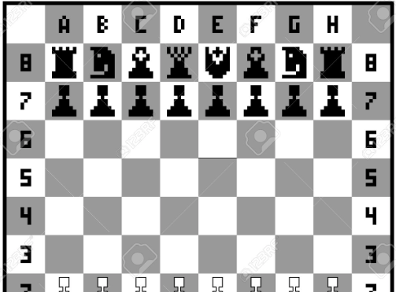
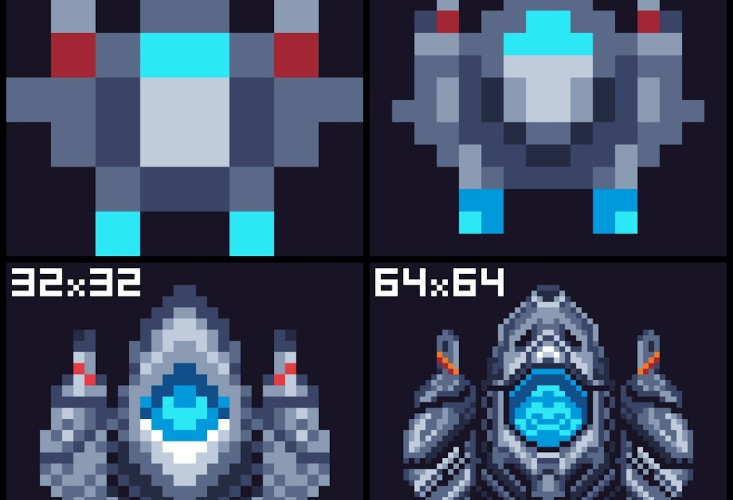



Home Décor Embedded Systems 2025
Sage Marks and Matt Krueger

Slide 2
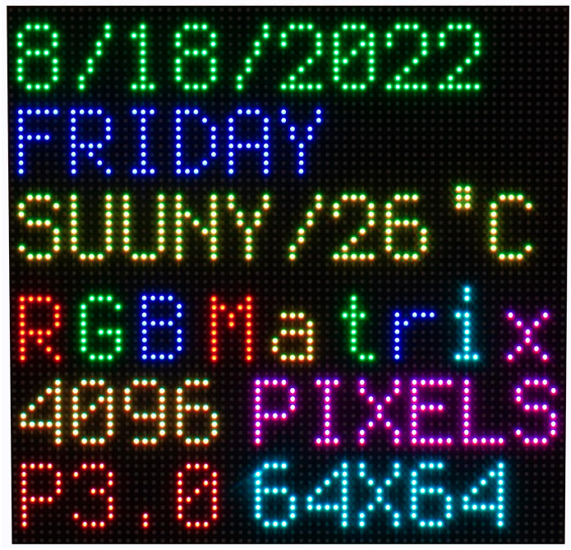
Project Description
Problem: We want unique electronic artwork in our apartment
Solution: Bluetooth controlled 64x64 LED Matrix
This embedded systems project is a starting point for a Bluetooth controlled LED display project, utilizing an ATmega328P and an LED Matrix. Additional user interaction can be achieved with RPGs and pushbuttons as we have solid understanding of these components.
Showed in class, The Bluetooth remote controlled car had Bluetooth communication via an application, we are envisioning a similar approach. If allowed, a locally run server would be easy to implement and allow for more features.

Slide 3
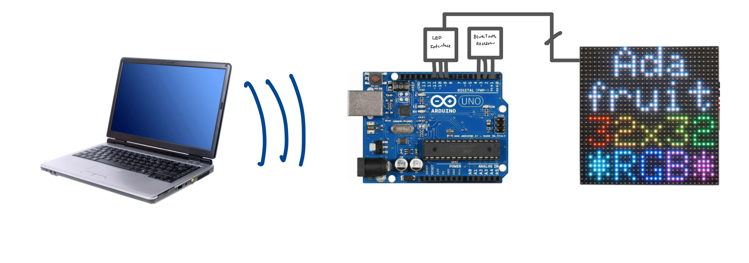

High Level Workflow
Bluetooth Application
Locally run application that
Interfaces with Bluetooth.
User selects displays to be shown:
- Static
Dynamic
Game
Upload? Maybe there is a C library for img -> 64x64 px
2. Arduino Analysis:
Interpret signal to drive LED
Handle selections via BT:
Compute LED row/col and RGB
Send to LED Matrix
3. User Interface:
Display image on 64x64
LED matrix

Slide 4
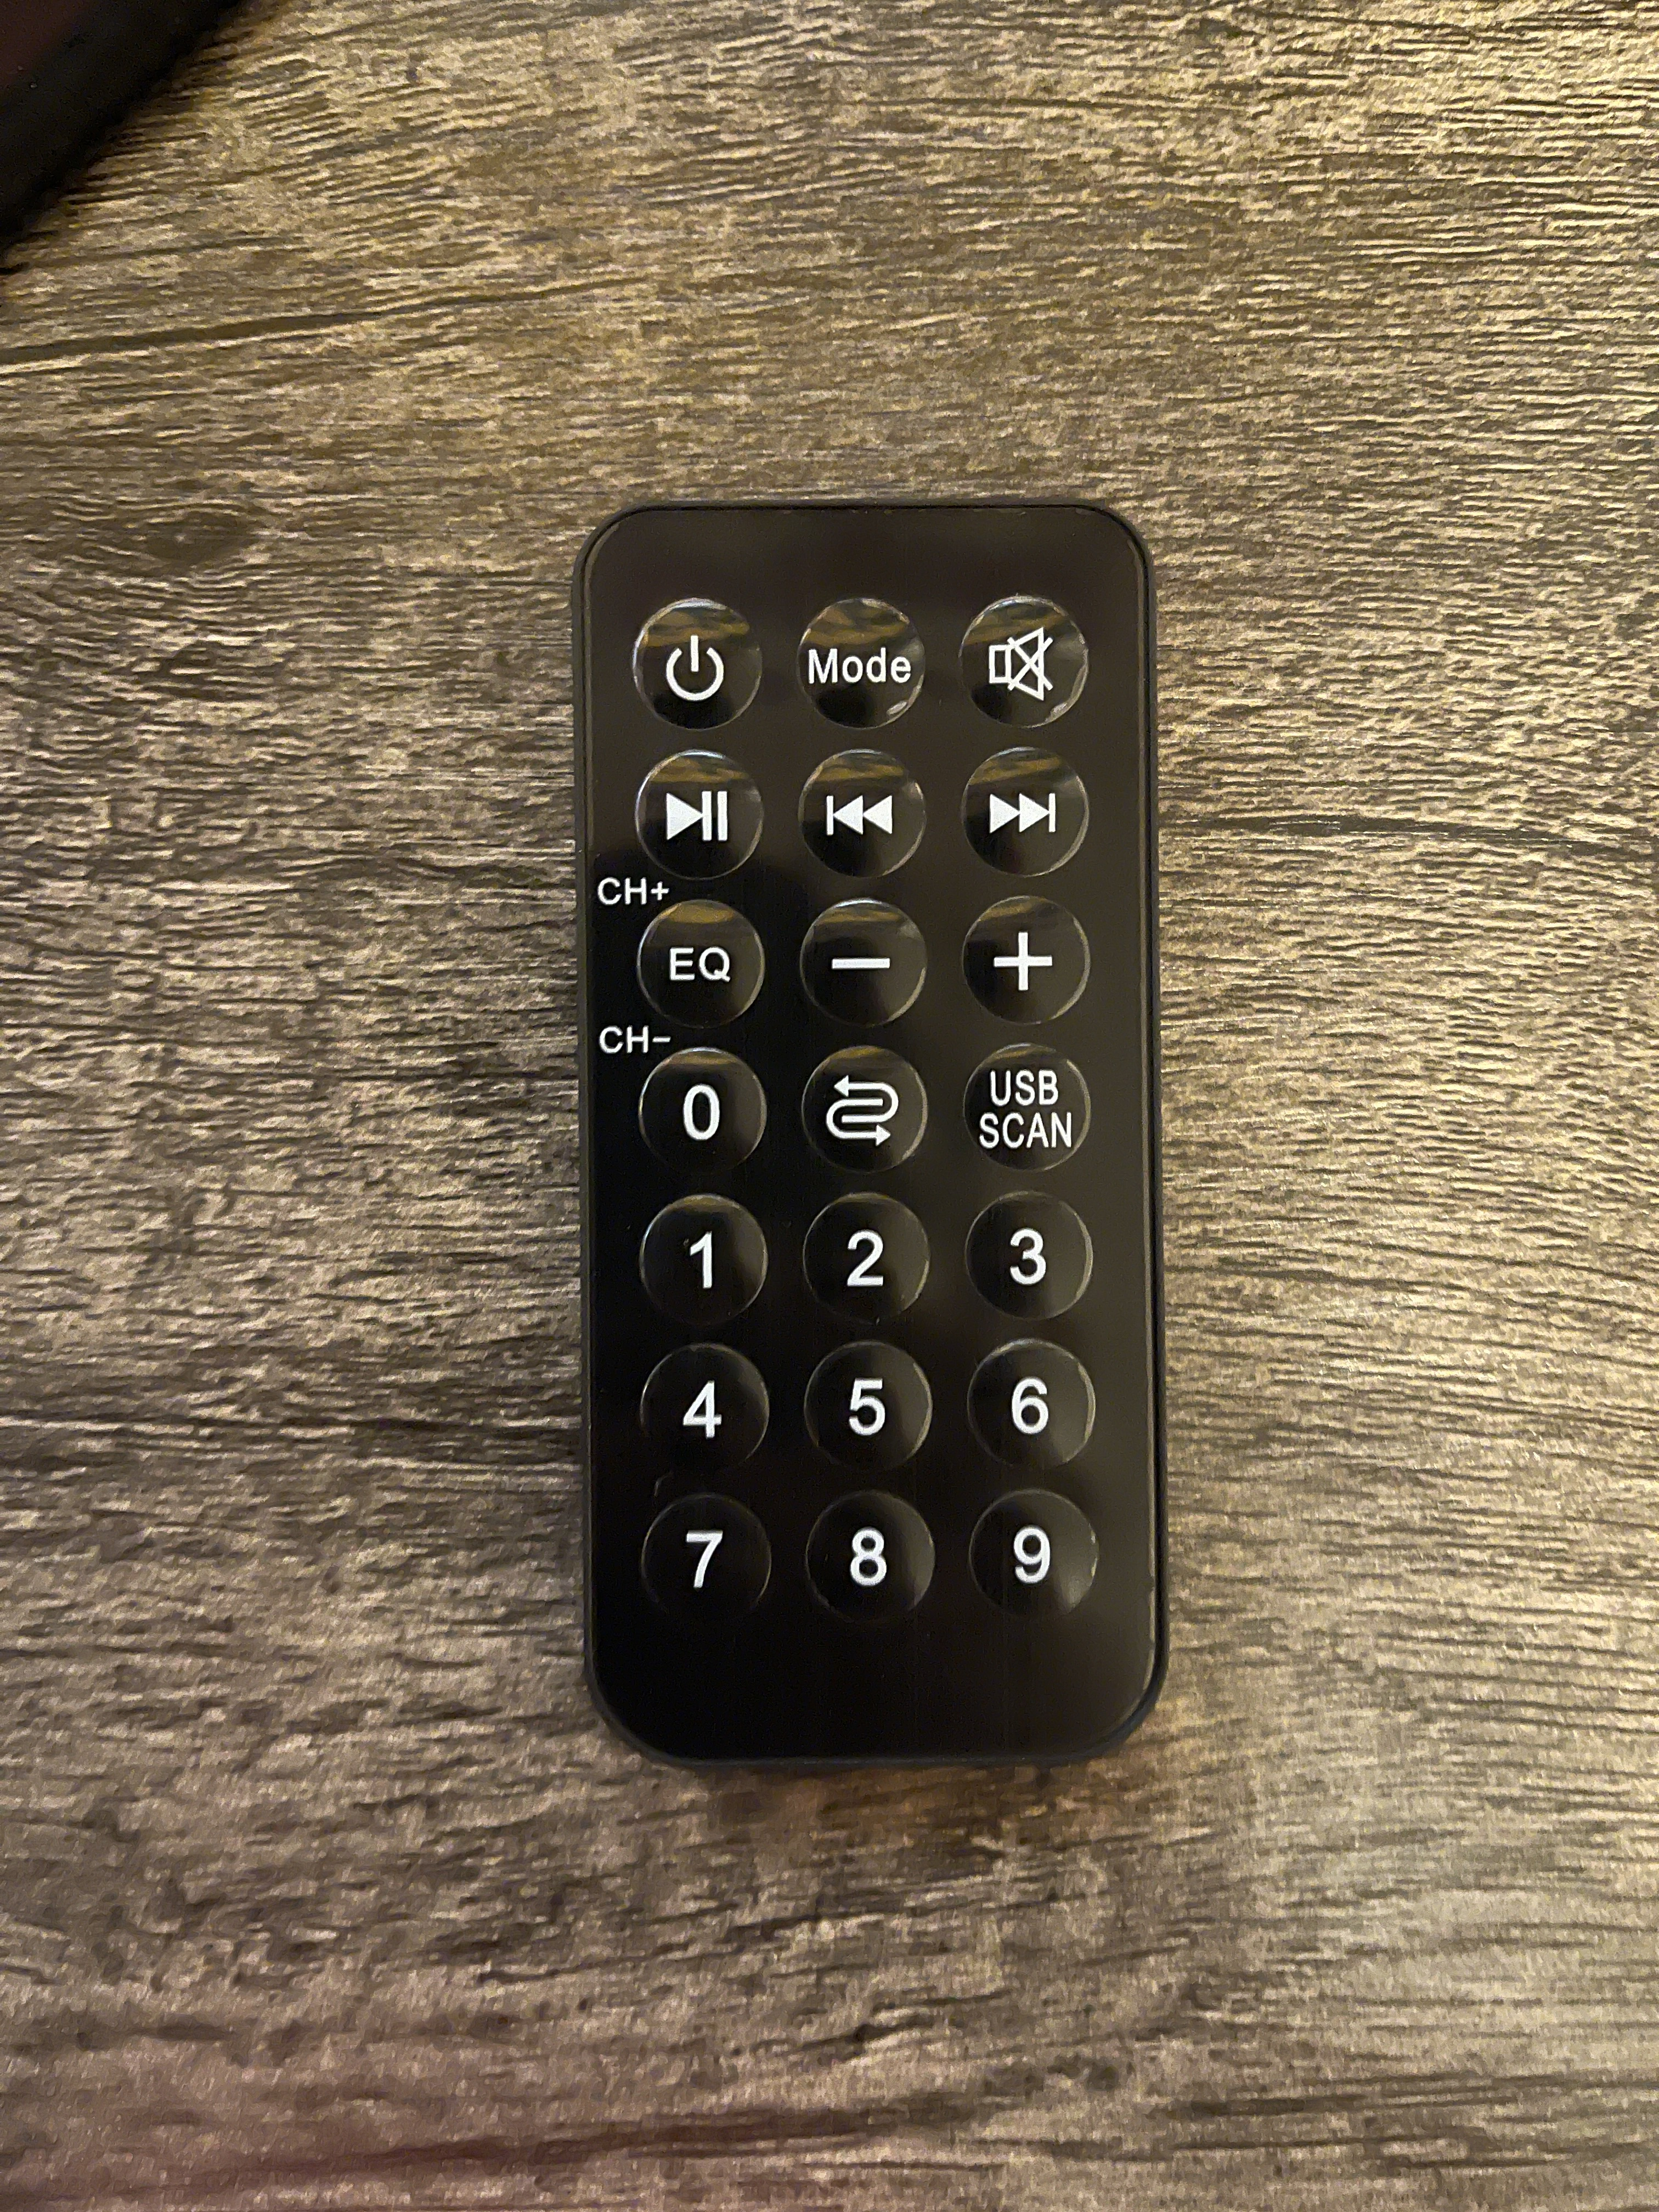
Alternative 1
IR Remote
Included in Embedded Systems Kit
User selects displays to be shown:
- Static
Dynamic
Game
2. Arduino Analysis:
Interpret signal to drive LED
Handle selections via Interrupts:
Compute LED row/col and RGB
Send to LED Matrix
3. User Interface:
Display image on 64x64
LED matrix

Slide 5
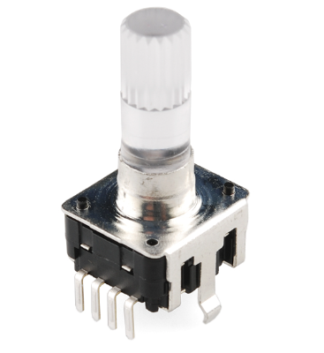
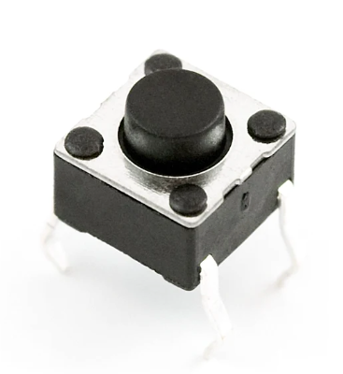
Alternative 2
Button(s) & RPG(s)
Included in Embedded Systems Kit
User selects displays to be shown:
- Static
Dynamic
Game
2. Arduino Analysis:
Interpret signal to drive LED
Handle selections via Interrupts:
Compute LED row/col and RGB
Send to LED Matrix
3. User Interface:
Display image on 64x64
LED matrix

Slide 6
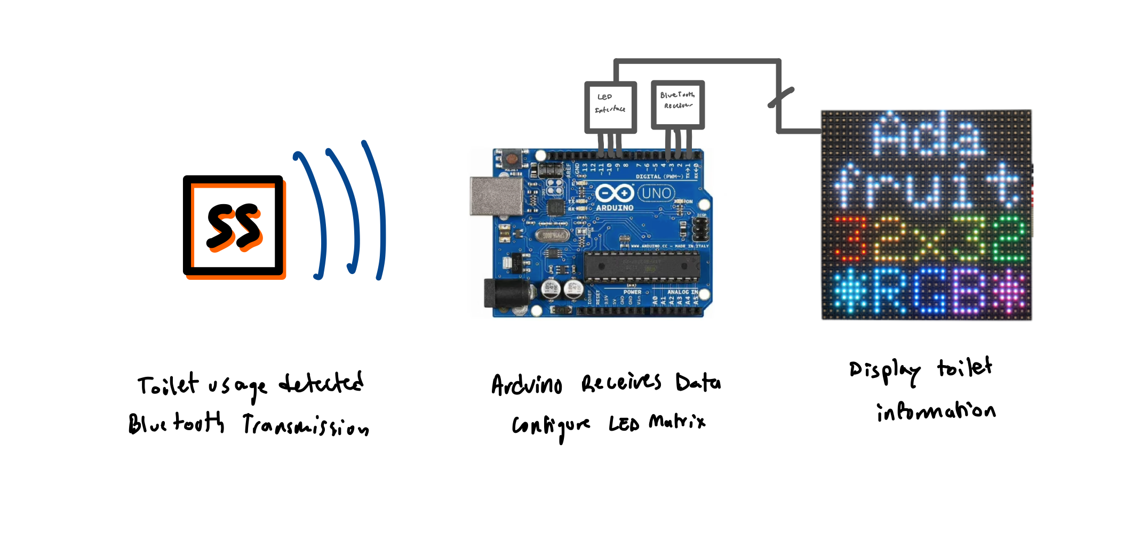
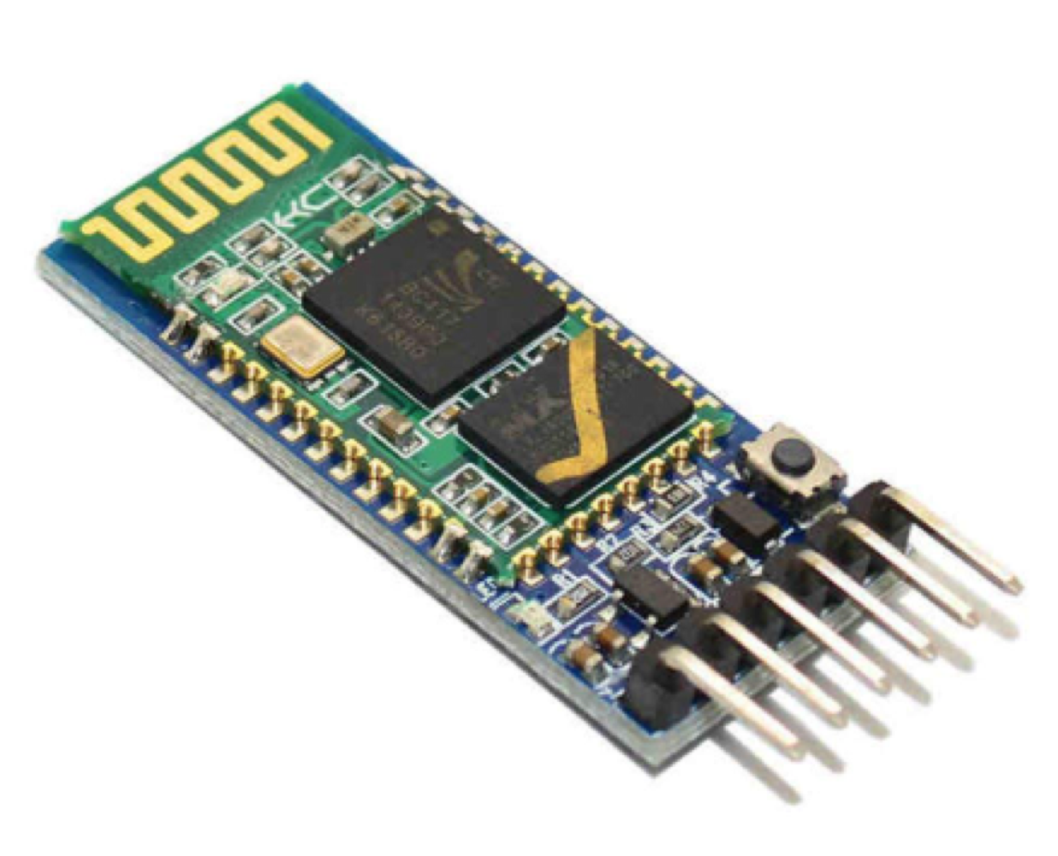
Required Components
Component | Amount | Usage
Arduino Uno µc | 1 | Analysis and LED Matrix Interface
HC-05 Bluetooth Chip | 1 | Interface for µc Bluetooth transmission/reception
64x64 LED Matrix | 1 | Display availability
RPG/Button/IR transmitter | TBD | Additional UI for µc
*We have matrix and IR already… just need to buy the HC-05 BT chip

